Slide 1
Q-Search: Designing Neural Network Architectures using Reinforcement Learning
Author: Nattapat Juthaprachakul
MSc Computing Science
Supervisor: Professor Wayne Luk
Acknowledgement: Dr. Ce Guo

Slide 2
Introduction
Convolutional Neural Network(CNN) architectures
Applications: image recognition/classification, speech recognition,
machine translation and etc.
Models: AlexNet, VGGNet, GoogleNet, ResNet, etc.

Slide 3
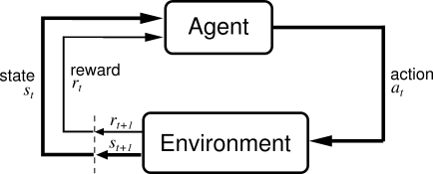
Reinforcement Learning

Slide 4
Q-Search
Layer type and Number of Layer
Layer Selection Procedure
Q-Learning
Epsilon-Greedy(ε)
Periodic Experience Replay

Slide 5
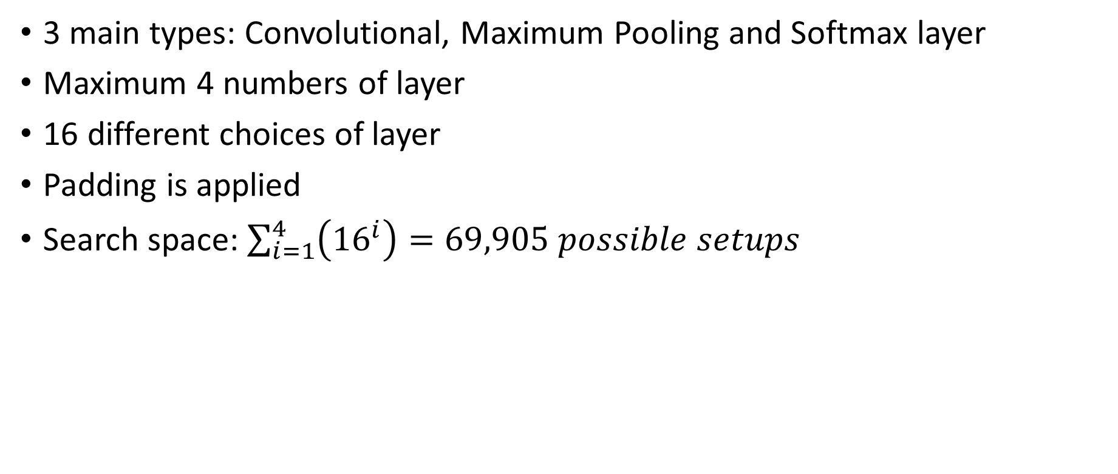
Layer Type and Number of layer
3 main types: Convolutional, Maximum Pooling and Softmax layer
Maximum 4 numbers of layer
16 different choices of layer
Padding is applied
Search space: $\sum_{i=1}^{4}{\left({16}^{i}\right)=69,905 possible setups}$

Slide 6
Layer Name | Layer Type | Filter Number | Kernel Size | Stride Number
c1 | Convolution | 32 | 3x3 | 1
c2 | Convolution | 32 | 4x4 | 1
c3 | Convolution | 32 | 5x5 | 1
c4 | Convolution | 36 | 3x3 | 1
c5 | Convolution | 36 | 4x4 | 1
c6 | Convolution | 36 | 5x5 | 1
c7 | Convolution | 48 | 3x3 | 1
c8 | Convolution | 48 | 4x4 | 1
c9 | Convolution | 48 | 5x5 | 1
c10 | Convolution | 64 | 3x3 | 1
c11 | Convolution | 64 | 4x4 | 1
c12 | Convolution | 64 | 5x5 | 1
m1 | Maximum Pooling | - | 2x2 | 2
m2 | Maximum Pooling | - | 3x3 | 2
m3 | Maximum Pooling | - | 3x3 | 3
s | Softmax | - | - | -

Slide 7
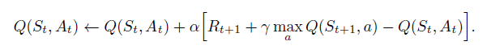
Q-Learning
Model-free reinforcement learning algorithm
Q-Table
Q-learning rate(α) = 0.01
Discount factor(γ) = 1
State = 4 Layers
Action: 16 types of layer
Q-Table

Slide 8
Epsilon-Greedy Strategy(ε):
Random action with probability = ε
Greedy action (argmax Q(s,a)) with probability = 1 – ε
Epsilon(ε) | 1.0 | 0.9-0.7 | 0.6-0.1
Number of model trained | 1500-2500 | 500-1000 | 500-800

Slide 9
Experience Replay: Periodic Update
Store name, topology and validation accuracy.
Ways of using Experience Replay in Q-Search
Not using Experience Replay
Sample models from Experience Replay to update Q-table every time the agent finishes train new model.
Sample models from Experience Replay to update Q-table every 100 episodes. (Periodic Update)

Slide 10
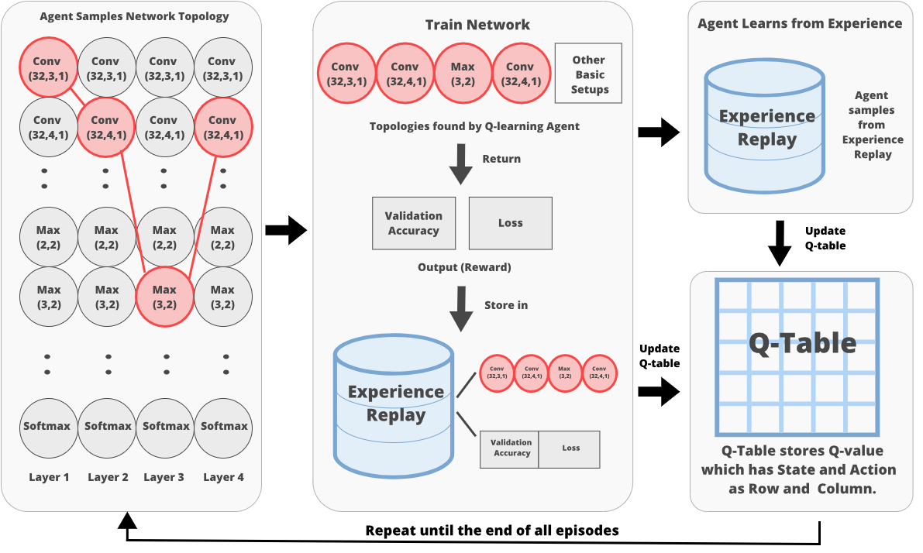

Slide 11
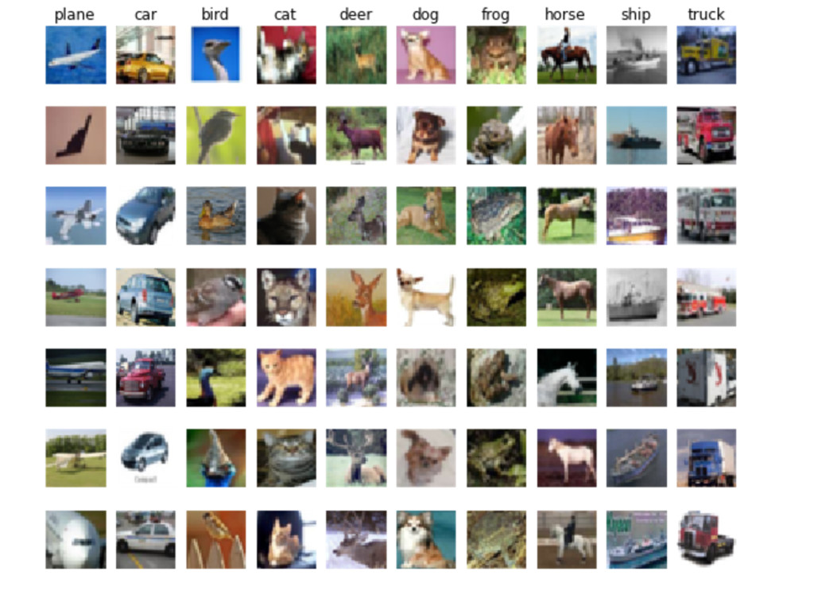

Datasets
MNIST
CIFAR-10

Slide 12
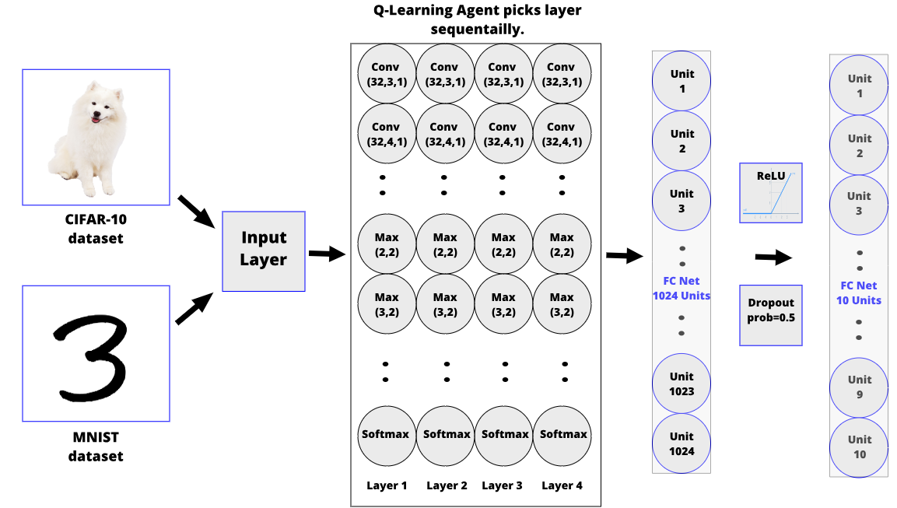

Slide 13
Q-Search: MNIST Dataset

Slide 14
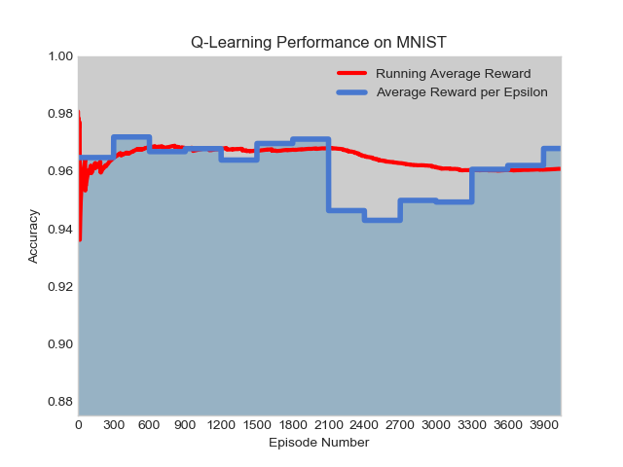
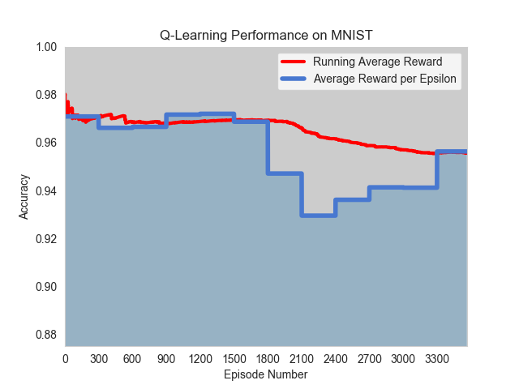
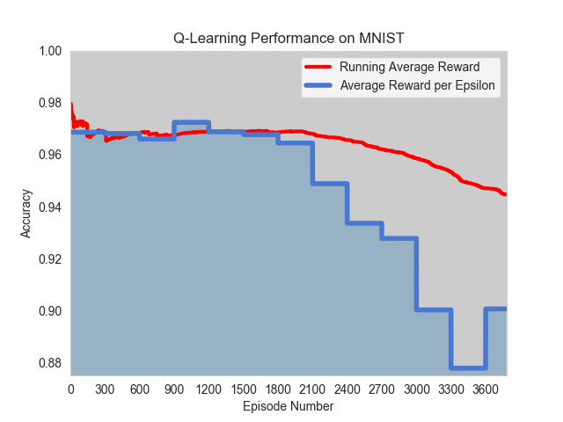
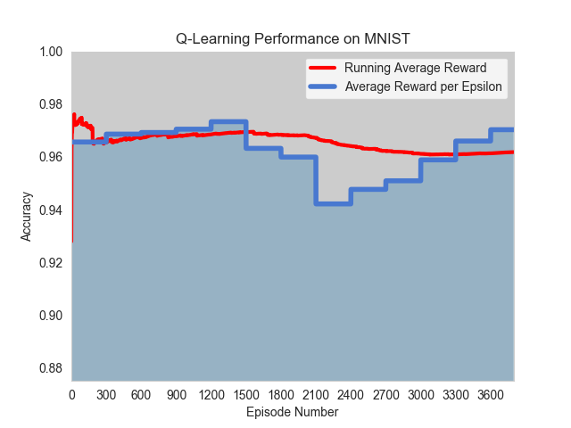
Result of Q-Search on MNIST of all experiments
Experiment No. | Total Episode | No. of model sampled to update Q-table/ Experience Replay Technique | Training Time | Best Accuracy
1 | 3800 | - | 5 days | 97.66%
2 | 3500 | 10 / After finish training new model | 5 days | 97.65%
3 | 3800 | 50 / After finish training new model | 6 days | 97.59%
4 | 3800 | 50 / Update Q-table every 100 episodes | 3 days | 97.67%
1
2
3
4

Slide 15
Q-Search: CIFAR-10 Dataset

Slide 16
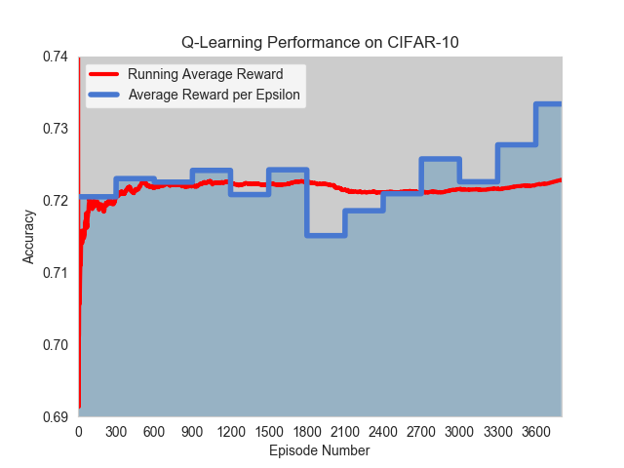
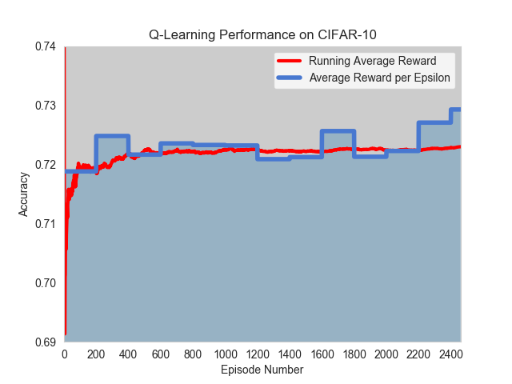
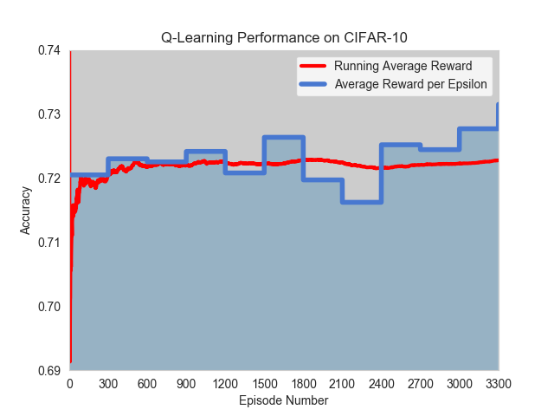
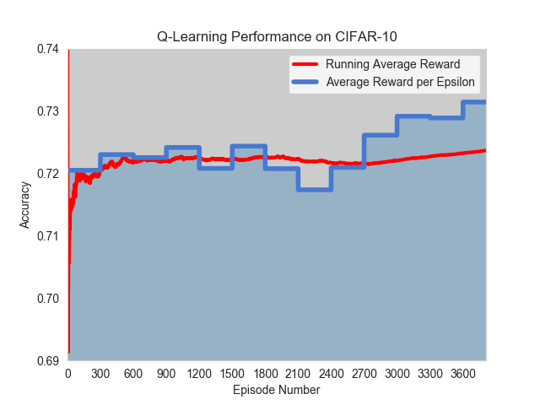
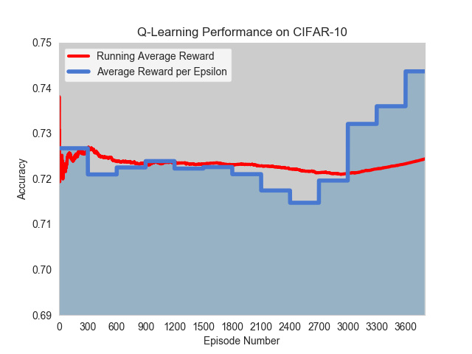
Result of Q-Search on CIFAR-10 of all experiments
Experiment No. | Total Episode | No. of model sampled to update Q-table/ Experience Replay Technique | Training Time | Best Accuracy
1 | 3600 | - | 11 days | 80.09%
2 | 2500 | 5 / After finish training new model | 8 days | 79.12%
3 | 3300 | 5 / After finish training new model | 10 days | 80.00%
4 | 3800 | 5 / After finish training new model | 11 days | 79.41%
5 | 3800 | 50 / Update Q-table every 100 episodes | 6 days | 80.17%
Note: validation accuracy benchmark for shallow network is 77%. (McDonnell and Vladusich (2015))
1
2
3
4
5

Slide 17
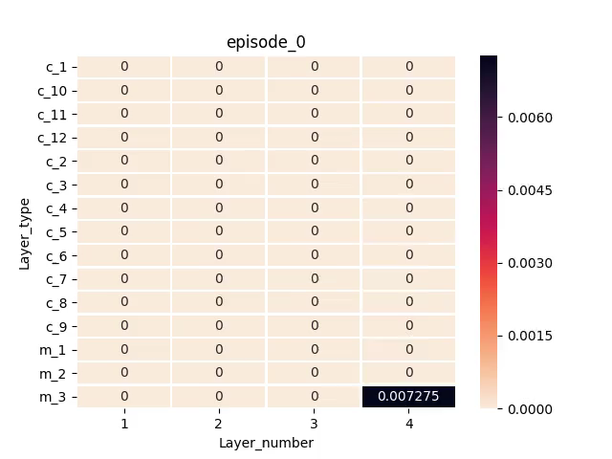
Q-Search: Experiment 5 -Periodic Experience Replay Update

Slide 18
Conclusion
Periodic Experience Replay Update
Future Work
Periodic Experience Replay Update with lower number of episodes
More flexible in type and number of layers

Slide 19
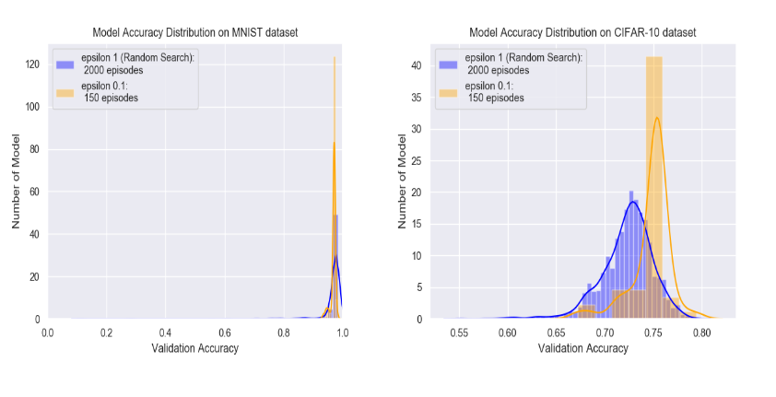
Conclusion
Algorithm / Dataset | Accuracy for MNIST | Accuracy for CIFAR-10
Random Search | 98.13% | 80.18%
Layerwise Search | 97.46% | 75.72%
Q-Search | 97.67% | 80.17%

Slide 20
Appendix

Slide 21
Experimental Setups
Random Search
Layerwise Search
Q-Search

Slide 22
Q-Search: MNIST

Slide 23
Experiment 1
Epsilon | 1.0 | 0.9-0.7 | 0.6-0.1
Episode | 2000 | 1000 | 800
Total episode: 3800
Not using Experience Replay updating technique
Training time: 5 days

Slide 24
Experiment 2
Epsilon | 1.0 | 0.9-0.7 | 0.6-0.1
Episode | 2500 | 500 | 500
Total episode: 3500
Sample 10 models from Experience Replay after finish training new model to update Q-table.
Training time: 5 days

Slide 25
Experiment 3
Epsilon | 1.0 | 0.9-0.7 | 0.6-0.1
Episode | 2000 | 1000 | 800
Total episode: 3800
Sample 50 models from Experience Replay after finish training new model to update Q-table.
Training time: 6 days

Slide 26
Experiment 4
Epsilon | 1.0 | 0.9-0.7 | 0.6-0.1
Episode | 2000 | 1000 | 800
Total episode: 3800
Sample 50 models from Experience Replay every 100 episodes to update Q-table.
Training time: 3 days

Slide 27
Q-Search: CIFAR-10

Slide 28
Experiment 1
Epsilon | 1.0 | 0.9-0.7 | 0.6-0.1
Episode | 1800 | 1000 | 800
Total episode: 3600
Not using Experience Replay updating technique
Training time: 11 days

Slide 29
Experiment 2
Epsilon | 1.0 | 0.9-0.7 | 0.6-0.1
Episode | 1500 | 500 | 500
Total episode: 2500
Sample 5 models from Experience Replay after finish training new model to update Q-table.
Training time: 8 days

Slide 30
Experiment 3
Epsilon | 1.0 | 0.9-0.7 | 0.6-0.1
Episode | 2000 | 800 | 500
Total episode: 3300
Sample 5 models from Experience Replay after finish training new model to update Q-table.
Training time: 10 days

Slide 31
Experiment 4
Epsilon | 1.0 | 0.9-0.7 | 0.6-0.1
Episode | 2000 | 1000 | 800
Total episode: 3800
Sample 5 models from Experience Replay after finish training new model to update Q-table.
Training time: 11 days

Slide 32
Experiment 5
Epsilon | 1.0 | 0.9-0.7 | 0.6-0.1
Episode | 2000 | 1000 | 800
Total episode: 3800
Sample 50 models from Experience Replay every 100 episodes to update Q-table.
Training time: 6 days

